Slide 1
Multiplication Table
x | 0 | 1 | 2 | 3 | 4 | 5 | 6 | 7 | 8 | 9 | 10 | 11 | 12
0 | 0 | 0 | 0 | 0 | 0 | 0 | 0 | 0 | 0 | 0 | 0 | 0 | 0
1 | 0 | 1 | 2 | 3 | 4 | 5 | 6 | 7 | 8 | 9 | 10 | 11 | 12
2 | 0 | 2 | 4 | 6 | 8 | 10 | 12 | 14 | 16 | 18 | 20 | 22 | 24
3 | 0 | 3 | 6 | 9 | 12 | 15 | 18 | 21 | 24 | 27 | 30 | 33 | 36
4 | 0 | 4 | 8 | 12 | 16 | 20 | 24 | 28 | 32 | 36 | 40 | 44 | 48
5 | 0 | 5 | 10 | 15 | 20 | 25 | 30 | 35 | 40 | 45 | 50 | 55 | 60
6 | 0 | 6 | 12 | 18 | 24 | 30 | 36 | 42 | 48 | 54 | 60 | 66 | 72
7 | 0 | 7 | 14 | 21 | 28 | 35 | 42 | 49 | 56 | 63 | 70 | 77 | 84
8 | 0 | 8 | 16 | 24 | 32 | 40 | 48 | 56 | 64 | 72 | 80 | 88 | 96
9 | 0 | 9 | 18 | 27 | 36 | 45 | 54 | 63 | 72 | 81 | 90 | 99 | 108
10 | 0 | 10 | 20 | 30 | 40 | 50 | 60 | 70 | 80 | 90 | 100 | 110 | 120
11 | 0 | 11 | 22 | 33 | 44 | 55 | 66 | 77 | 88 | 99 | 110 | 121 | 132
12 | 0 | 12 | 24 | 36 | 48 | 60 | 72 | 84 | 96 | 108 | 120 | 132 | 144

Slide 2

Real life application of mathematics
Where can we see the use of multiplication and division in real life?

Slide 3



What was found on Friday…

Slide 4
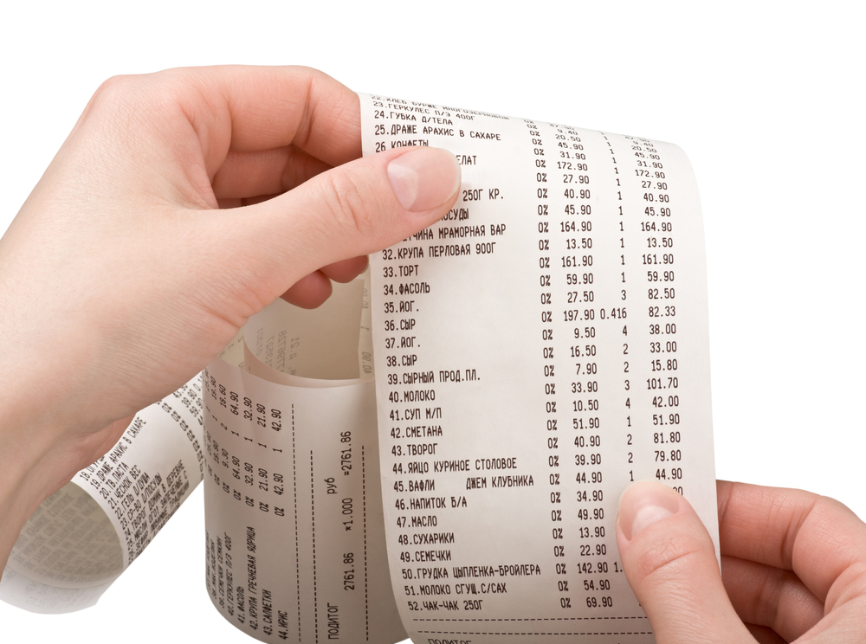

Slide 5
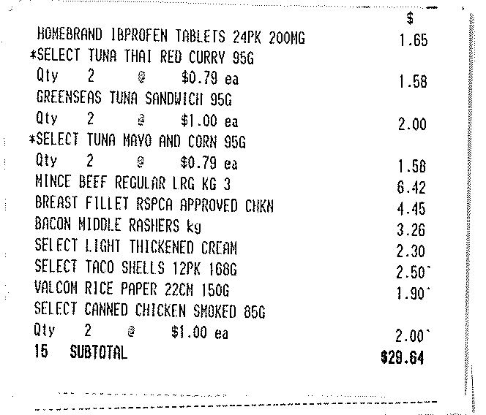

Slide 6
Your task
Create your own receipt by ‘shopping’!
Use multiplication/division to help with your shopping.

Slide 7
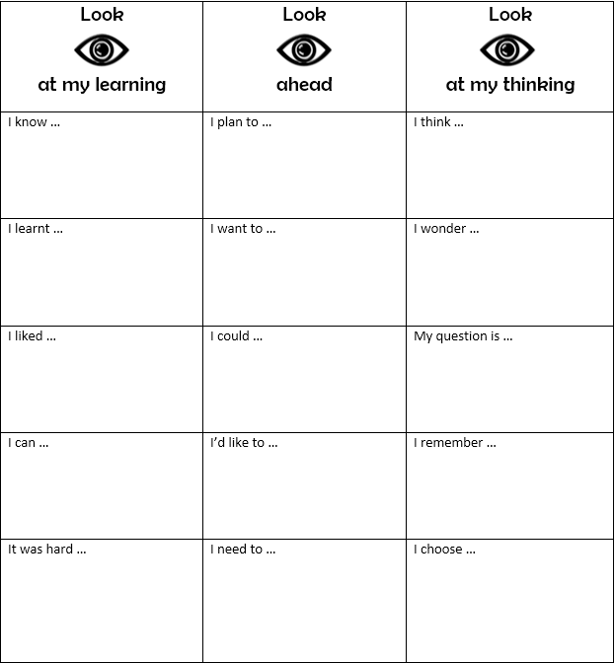
Reflection

